Slide 1
Industrial Structure
and Capital Flows
Author:
Keyu Jin
Present by:
Mingxi Yan

Slide 2
Standard open–economy framework
“Convergence” effect
If productivity A is the same across countries, then countries with less capital per worker K/L have a higher marginal product, which would provide a higher return on capital investment.
As a consequence, the model predicts that in a world of open market economies and global financial capital, investment will flow from rich countries to poor countries, until capital/worker K/L and income/worker Y/L equalize across countries.
––––Solow–Swan model in Wikipedia

Slide 3
Standard open–economy framework
“Convergence” effect
Country A
Country B
Lower capital-labor ratio
Higher capital-labor ratio

Slide 4
In reality
a permanent increase in the labor-force or labor productivity in a country can induce a net capital outflow
capital can flow from developing countries to advanced economies when these countries integrate
Country A
Country B
➔A new force driving international capital flows
“composition” effect

Slide 5
Why standard open–economy models don’t work?
The basic underlying assumption in these workhorse frameworks is that countries cannot engage in intertemporal commodity trade but only in intertemporal trade.
This assumption becomes untenable when these large-scale forces alter a country's comparative advantage, and consequently, its structure of trade.
How can changes in the structure of trade and specialization patterns affect capital flows?

Slide 6
One extreme case
A labor force/productivity boom in Foreign can only lead to a capital outflow
home
foreign
capital flow
fully specializes in producing capital-instensive good
fully specializes in producing labor-instensive good
capital
labor
labor

Slide 7
More general case
facing greater investment demands
generating a high share of output accruing to investment
generating a low share of output accruing to labor income
generating a low share of output accruing to investment
generating a high share of output accruing to labor income
home
foreign
capital flow
Industrial structure: tilted toward capital-intensive sectors
Industrial structure: tilted toward labor-intensive sectors
a country that experiences a labor force/productivity shock
capital
labor
capital
labor

Slide 8

Consider a world with two countries, Home ( h ) and Foreign ( f ), each characterized by an overlapping generations economy in which consumers live for two periods. A consumer supplies one unit of labor when young and does not work when old.
Each country uses identical technology to produce intermediate goods i=1,…m, which are traded freely and costlessly. Intermediate goods are combined produce a composite good that is used for consumption and investment.
Preferences and production technologies are assumed to have the same structure values across countries. However, the technologies differ in two country, the labor input consists only of domestic labor, and intermediate-producing firms are subject to country-specific productivity and labor force shocks.
Henceforth, j denotes countries and i denotes sectors.
model

Slide 9
equilibrium
ASSUMPTION 1: Unitary elasticity of substitution of intermediate goods (θ=1).
ASSUMPTION 2: Consumers have logarithmic preferences (ρ= 1).
ASSUMPTION 3: The capital-adjustment technology is log-linear.

Slide 10
The composition effect
This is a special case in which the standard convergence effect is shut down and the composition effect operates in isolation. In this case, a closed-form solution arises when relying on the additional assumption:
ASSUMPTION 4: The most labor-intensive sector uses only labor as an input no capital in the production technology, i.e.,α1= 0.

Slide 11
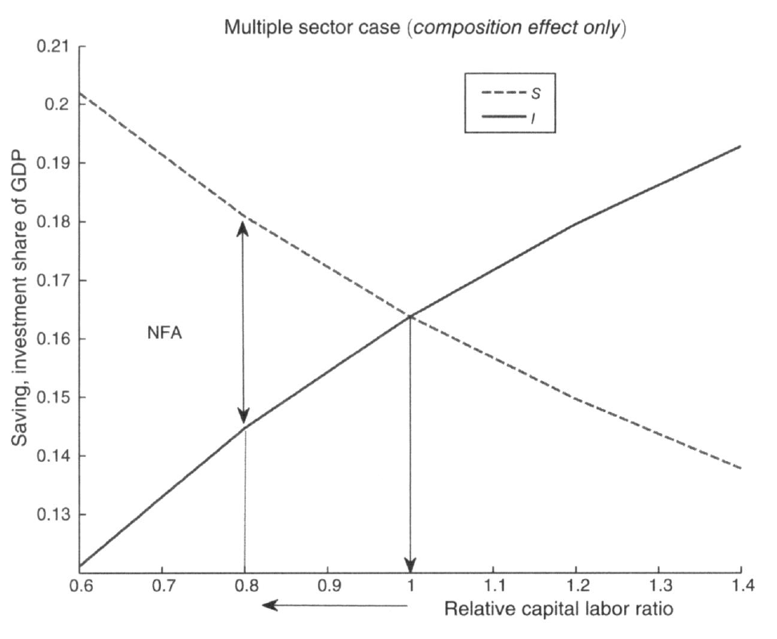
The composition effect

Slide 12
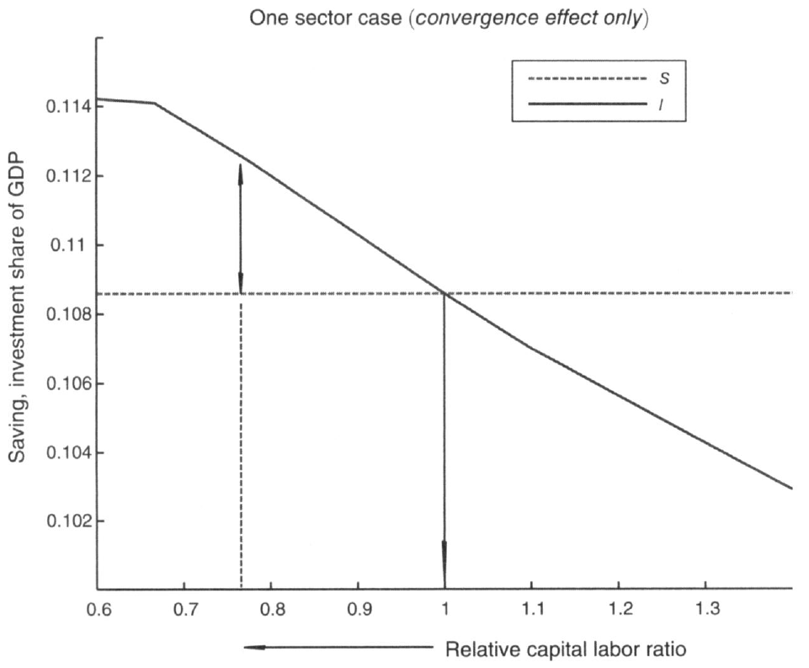
The convergence effect

Slide 13




International Capital Flows
PROPOSITION 1(Globalization): Suppose that all countries are initially in autarky prior to period t, and unexpectedly open up to trade and capital flows at t. Then
PROPOSITION 2 (Labor Force/Productivity Shock) : Suppose that all countries are open at t. A high in country j causes a net capital outflow in j, at t.
PROPOSITION 4 (Path Dependence): The evolution of the depends on j's initial weighted-average share of capital stock in the world, the higher the initial weighted-average share of capital in j, the higher the effective capital-labor ratio in j at every point on the transitional path.

Slide 14
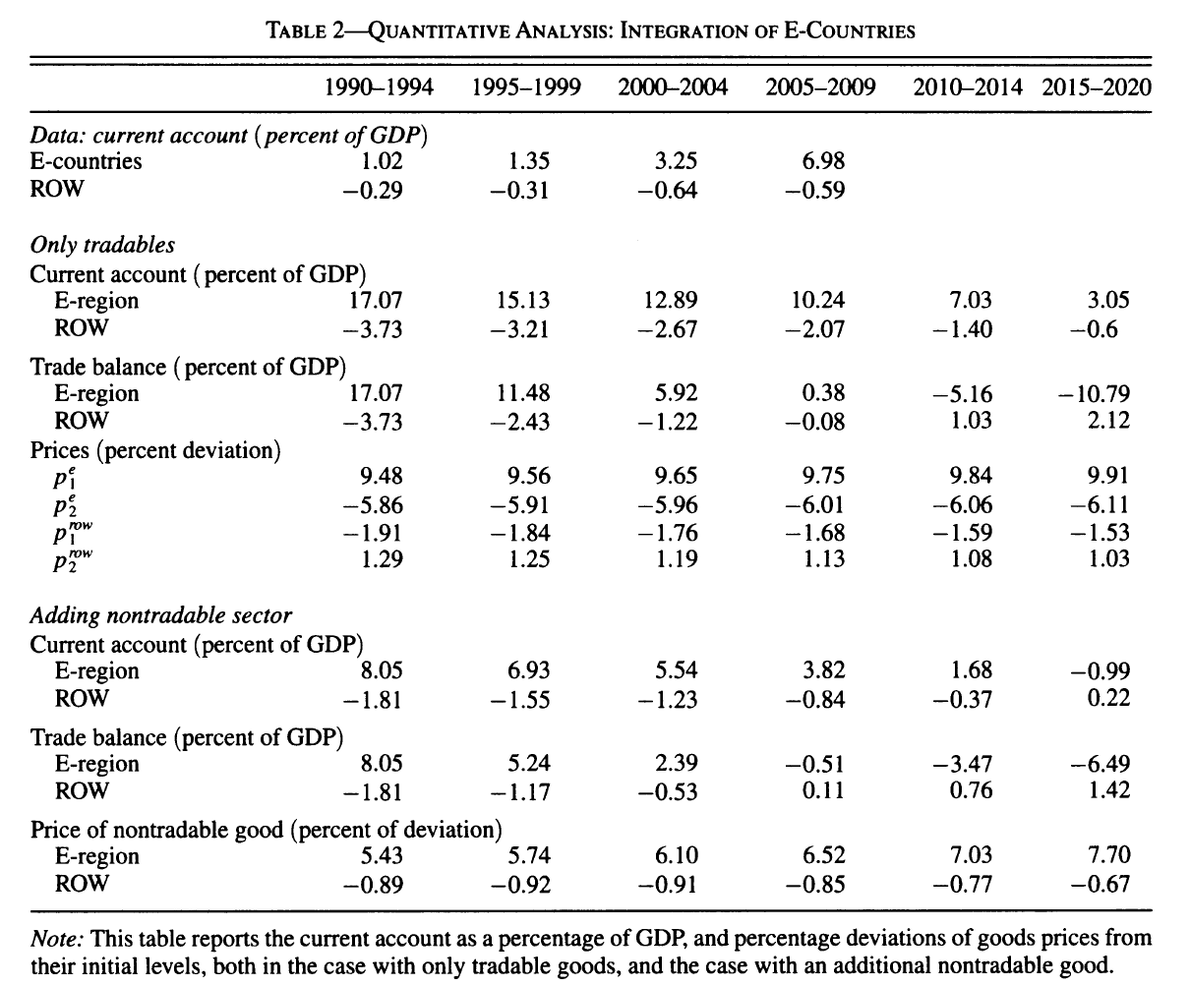
Quantitative Analysis

Slide 15
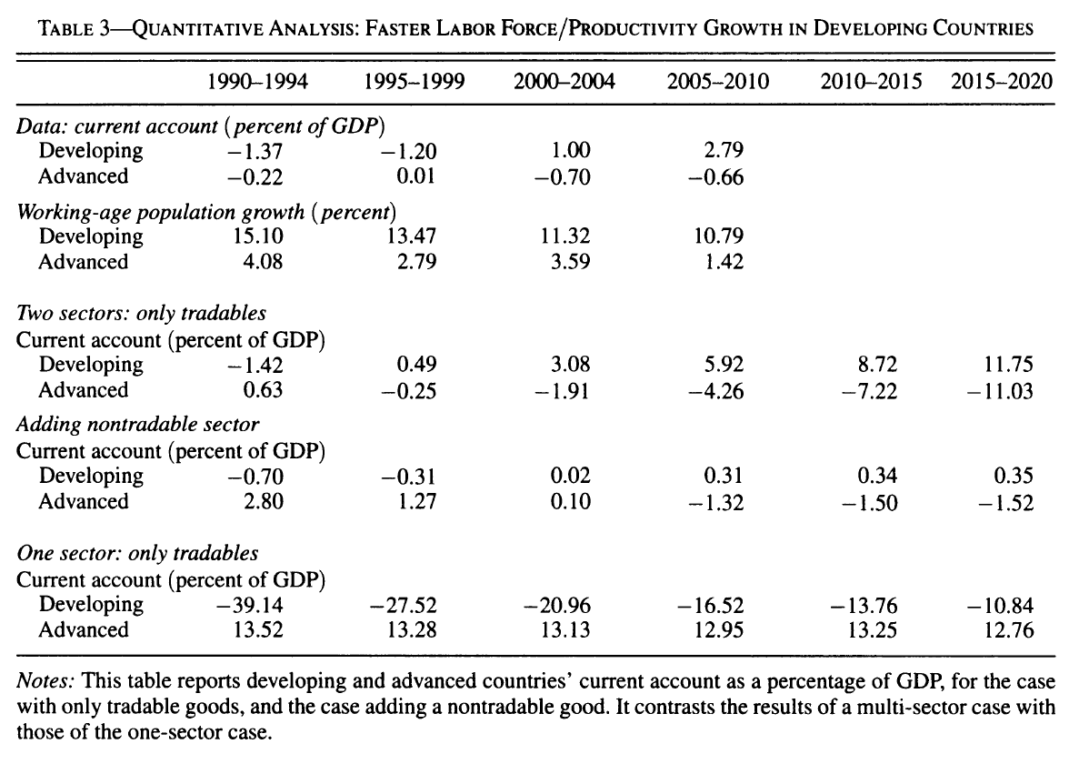
Quantitative Analysis

Slide 16
My opinions
Great economic model.
What about tariff?
The capital flow from China to Southeastern Asia

Slide 17
THANKS.
-Mingxi

